Slide 1

The Battle of Neighborhoods – Study of best neighborhoods to open a new shopping mall in Mumbai, India.
Submitted by: -
Hardik Ruparelia
August 5, 2020

Slide 2
Business Problem
The aim of this capstone project is to analyze and select the best location in the city of Mumbai, India to open a new shopping mall.
Question: If a property developer is looking to build a shopping mall, where would you recommend that they open it in the city of Mumbai?
By using data science methodology and machine learning techniques like clustering, classification we will try to find the solution to above question

Slide 3
Data
List of the neighborhoods in Mumbai.
Source: https://en.wikipedia.org/wiki/Category:Neighbourhoods_in_Mumbai
Latitude and longitude of each neighborhood
We use python geocoder package to obtain latitude and longitude of each neighborhood in Mumbai city.
Obtain venue data for each neighborhood
We use Foursquare API to get the venues in each neighborhood.

Slide 4
Methodology
Web scraping Wikipedia page for neighborhoods list
Get latitude and longitude coordinates using Geocoder
Use Foursquare API to get venue data
Group data by neighborhood and taking the mean of the frequency of occurrence of each venue category
Filter venue category by Shopping Mall
Perform clustering on the data by using k-means clustering
Visualize the clusters in a map using Folium

Slide 5
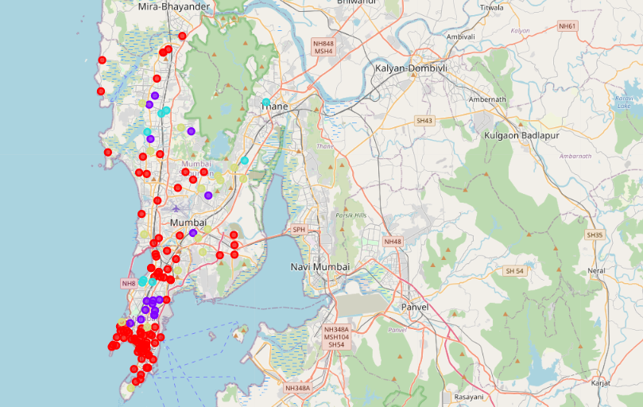
Results
Cluster 1: Neighborhoods with highest number of shopping malls
Cluster 2: Neighborhoods with moderate number of shopping malls
Cluster 3: Neighborhoods with low number of shopping malls
Cluster 4: Neighborhoods with moderate number of shopping malls

Slide 6
Discussion
Most of the shopping malls are concentrated in the central area of the city
Highest number of malls in cluster 1 and moderate number in cluster 2 and cluster 4
Cluster 3 has very low number to no shopping mall in the neighborhoods

Slide 7
Conclusion
Answer to business question: The neighborhoods in cluster 3 are the most preferred locations to open a new shopping mall
Findings of this project will help the relevant stakeholders to capitalize on the opportunities on high potential locations while avoiding overcrowded areas in their decisions to open a new shopping mall.

